Slide 1
Distributed File Systems

Slide 2
DFS Overview
DFS Issues
  Security
  Transparency
  Performance
  Reliability
  Availability
  …
File System
Service
Client
Client
Client

Slide 3
DFS Overview (Cont.)
Distributed file system (DFS) – a distributed implementation of the classical time-sharing model of a file system, where multiple users share files and storage resources.
A DFS manages set of dispersed storage devices
Overall storage space managed by a DFS is composed of different, remotely located, smaller storage spaces.
There is usually a correspondence between constituent storage spaces and sets of files.

Slide 4
DFS Structure
Service – software entity running on one or more machines and providing a particular type of function to a priori unknown clients.
Server – service software running on a single machine.
Client – process that can invoke a service using a set of operations that forms its client interface.
A client interface for a file service is formed by a set of primitive file operations (create, delete, read, write).
Client interface of a DFS should be transparent, i.e., not distinguish between local and remote files.

Slide 5
Outline
Introduction
DFS Issues
  Naming and Transparency
  Remote File Access
  Stateful versus Stateless Service
  File Replication
Example Systems
  AFS (vs. NFS)

Slide 6
Naming and Transparency
Naming – mapping between logical and physical objects.
Multilevel mapping – abstraction of a file that hides the details of how and where on the disk the file is actually stored.
A transparent DFS hides the location where in the network the file is stored.
For a file being replicated in several sites, the mapping returns a set of the locations of this file’s replicas; both the existence of multiple copies and their location are hidden.

Slide 7
Naming Structures
Location transparency – file name does not reveal the file’s physical storage location.
  File name still denotes a specific, although hidden, set of physical disk blocks.
  Convenient way to share data.
  Can expose correspondence between component units and machines.
Location independence – file name does not need to be changed when the file’s physical storage location changes.
  Better file abstraction.
  Promotes sharing the storage space itself.
  Separates the naming hierarchy form the storage-devices hierarchy.

Slide 8
Naming Schemes
Files named by combination of their host name and local name; guarantees a unique systemwide name.
Attach remote directories to local directories, giving the appearance of a coherent directory tree; only previously mounted remote directories can be accessed transparently.
Total integration of the component file systems.
  A single global name structure spans all the files in the system.
  If a server is unavailable, some arbitrary set of directories on different machines also becomes unavailable.

Slide 9
DFS Approaches (Files Access)
Computation Migration
  Remote Service Oriented
  Caching (Blocks) for Performance
  Server Centric Data Management → Simple and Reliable
  Ex) NFS
Data Migration
  File Caching Oriented
  Cooperative Data Management → Complex but Scalable
  Ex) Andrew File System (AFS)

Slide 10
Remote File Access (Caching)
Reduce network traffic by retaining recently accessed disk blocks in a cache, so that repeated accesses to the same information can be handled locally.
  If needed data not already cached, a copy of data is brought from the server to the user.
  Accesses are performed on the cached copy.
  Files identified with one master copy residing at the server machine, but copies of (parts of) the file are scattered in different caches.
  Cache-consistency problem – keeping the cached copies consistent with the master file.

Slide 11
Cache Location - Disk vs. Memory
Advantages of disk caches
  More reliable.
  Cached data kept on disk are still there during recovery and don’t need to be fetched again.
Advantages of main-memory caches:
  Permit workstations to be diskless.
  Data can be accessed more quickly.
  Performance speedup in bigger memories.
  Server caches (used to speed up disk I/O) are in main memory regardless of where user caches are located; using main-memory caches on the user machine permits a single caching mechanism for servers and users.

Slide 12
Cache Update Policy
Write-through – write data through to disk as soon as they are placed on any cache. Reliable, but poor performance.
Delayed-write – modifications written to the cache and then written through to the server later. Write accesses complete quickly; some data may be overwritten before they are written back, and so need never be written at all.
  Poor reliability; unwritten data will be lost whenever a user machine crashes.
  Variation – scan cache at regular intervals and flush blocks that have been modified since the last scan.
  Variation – write-on-close, writes data back to the server when the file is closed. Best for files that are open for long periods and frequently modified.

Slide 13
Consistency
Is locally cached copy of the data consistent with the master copy?
Client-initiated approach
  Client initiates a validity check.
  Server checks whether the local data are consistent with the master copy.
Server-initiated approach
  Server records, for each client, the (parts of) files it caches.
  When server detects a potential inconsistency, it must react.

Slide 14
Comparing Caching & Remote Service
In caching, many remote accesses handled efficiently by the local cache; most remote accesses will be served as fast as local ones.
Servers are contracted only occasionally in caching (rather than for each access).
  Reduces server load and network traffic.
  Enhances potential for scalability.
Remote server method handles every remote access across the network; penalty in network traffic, server load, and performance.
Total network overhead in transmitting big chunks of data (caching) is lower than a series of responses to specific requests (remote-service).

Slide 15
Caching & Remote Service (Cont.)
Caching is superior in access patterns with infrequent writes. With frequent writes, substantial overhead incurred to overcome cache-consistency problem.
Benefit from caching when execution carried out on machines with either local disks or large main memories.
Remote access on diskless, small-memory-capacity machines should be done through remote-service method.
In caching, the lower intermachine interface is different form the upper user interface.
In remote-service, the intermachine interface mirrors the local user-file-system interface.

Slide 16
Stateful File Service
Mechanism.
  Client opens a file.
  Server fetches information about the file from its disk, stores it in its memory, and gives the client a connection identifier unique to the client and the open file.
  Identifier is used for subsequent accesses until the session ends.
  Server must reclaim the main-memory space used by clients who are no longer active.
Increased performance.
  Fewer disk accesses.
  Stateful server knows if a file was opened for sequential access and can thus read ahead the next blocks.

Slide 17
Stateless File Server
Avoids state information by making each request self-contained.
Each request identifies the file and position in the file.
No need to establish and terminate a connection by open and close operations.

Slide 18
Distinctions Between
Stateful & Stateless Service
Failure Recovery.
  A stateful server loses all its volatile state in a crash.
    Restore state by recovery protocol based on a dialog with clients, or abort operations that were underway when the crash occurred.
    Server needs to be aware of client failures in order to reclaim space allocated to record the state of crashed client processes (orphan detection and elimination).
  With stateless server, the effects of server failure sand recovery are almost unnoticeable. A newly reincarnated server can respond to a self-contained request without any difficulty.

Slide 19
Distinctions (Cont.)
Penalties for using the robust stateless service:
  longer request messages
  slower request processing
  additional constraints imposed on DFS design
Some environments require stateful service.
  A server employing server-initiated cache validation cannot provide stateless service, since it maintains a record of which files are cached by which clients.
  UNIX use of file descriptors and implicit offsets is inherently stateful; servers must maintain tables to map the file descriptors to inodes, and store the current offset within a file.

Slide 20
File Replication
Replicas of the same file reside on failure-independent machines.
Improves availability and can shorten service time.
Naming scheme maps a replicated file name to a particular replica.
  Existence of replicas should be invisible to higher levels.
  Replicas must be distinguished from one another by different lower-level names.
Updates – replicas of a file denote the same logical entity, and thus an update to any replica must be reflected on all other replicas.
Demand replication – reading a nonlocal replica causes it to be cached locally, thereby generating a new nonprimary replica.

Slide 21
Outline
Introduction
DFS Issues
  Naming and Transparency
  Remote File Access
  Stateful versus Stateless Service
  File Replication
Example Systems
  AFS (vs. NFS)

Slide 22
Andrew File System (AFS)
A distributed computing environment under development since 1983 at Carnegie-Mellon University.
  http://www-2.cs.cmu.edu/afs/cs/project/coda/Web/docdir/scalable90.pdf
Design objectives
  Highly scalable: targeted to span over 5000 workstations.
  Secure: Little discussed here (see the above paper)
Andrew distinguishes between client machines (workstations) and dedicated server machines. Servers and clients run the 4.2BSD UNIX OS and are interconnected by an internet of LANs.

Slide 23
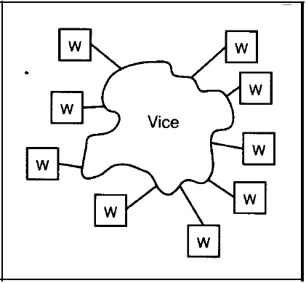
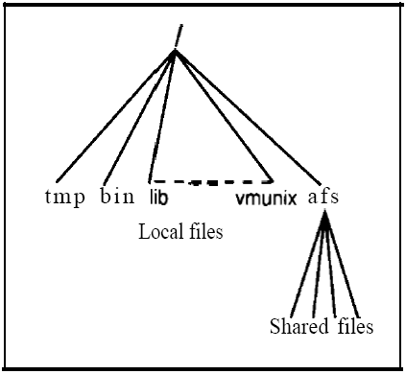
AFS (Cont.)
(trusted)
(un-trusted clients)
A high-level view of AFS architecture
File system view at a work station

Slide 24
AFS (Cont.)
Dedicated servers, called Vice, present the shared name space to the clients as an homogeneous, identical, and location transparent file hierarchy.
Clients are presented with a partitioned space of file names: a local name space and a shared name space.
The local name space is the root file system of a workstation, from which the shared name space descends.
Workstations run the Virtue protocol to communicate with Vice, and are required to have local disks where they store their local name space.

Slide 25
AFS (Cont.)
Clients and servers are structured in clusters interconnected by a backbone LAN.
A cluster consists of a collection of workstations and a cluster server and is connected to the backbone by a router.
Servers collectively are responsible for the storage and management of the shared name space.
A key mechanism selected for remote file operations is whole file caching. Opening a file causes it to be cached, in its entirety, on the local disk.

Slide 26
AFS Shared Name Space
Andrew’s volumes are small component units associated with the files of a single client.
A fid identifies a Vice file or directory. A fid is 96 bits long and has three equal-length components:
  volume number
  vnode number – index into an array containing the inodes of files in a single volume.
  uniquifier – allows reuse of vnode numbers, thereby keeping certain data structures, compact.
Fids are location transparent; therefore, file movements from server to server do not invalidate cached directory contents.
Location information is kept on a volume basis, and the information is replicated on each server.

Slide 27
AFS Shared Name Space (Cont.)
32 bits
32 bits
32 bits
path-name : fid
vol-num
vnode-num
uniquifier
0 … 010
0 … 011
server-i
server-j
vol-m
…
vol-n
vol-loc-db
vol-k
…
vol-3
vol-loc-db
j
inode #
USF
USF
USF
USF
…
…

Slide 28
AFS File Operations
Andrew caches entire files form servers. A client workstation interacts with Vice servers only during opening and closing of files.
Venus – caches files from Vice when they are opened, and stores modified copies of files back when they are closed.
Reading and writing bytes of a file are done by the kernel without Venus intervention on the cached copy.
Venus caches contents of directories and symbolic links, for path-name translation.
Exceptions to the caching policy are modifications to directories that are made directly on the server responsibility for that directory.

Slide 29
AFS Implementation
Client processes are interfaced to a UNIX kernel with the usual set of system calls.
Venus carries out path-name translation component by component.
The UNIX file system is used as a low-level storage system for both servers and clients. The client cache is a local directory on the workstation’s disk.
Both Venus and server processes access UNIX files directly by their inodes to avoid the expensive path name-to-inode translation routine.

Slide 30
AFS Implementation (Cont.)
Venus manages two separate caches:
  one for status
  one for data
LRU algorithm used to keep each of them bounded in size.
The status cache is kept in virtual memory to allow rapid servicing of stat (file status returning) system calls.
The data cache is resident on the local disk, but the UNIX I/O buffering mechanism does some caching of the disk blocks in memory that are transparent to Venus.

Slide 31
ASF vs. NFS – Summary
 | NFS | AFS
Objective | Simple and Reliable | Complete and Scaleable
Security | N/A | Dedicated Servers
 | N/A | Kerberos + Encryption
Naming | Location Transparency | Location Independence
File Access | Remote Service + Cache | File Cache Orient (in Disk)
Cache-Update Policy | Periodic Flush w/ Disk Sync | Write-On-Close
 | Write-Through (metadata) | Write-Through (directory)
Consistency | N/A | Server-Initiated (callback)
Service Type | Stateless | Stateful
Replication | N/A | Supported

Slide 32
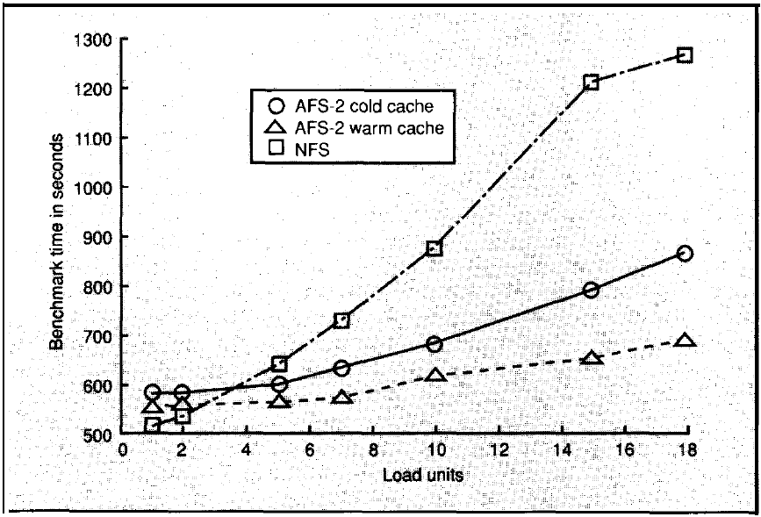
AFS vs. RPC – Performance
Load unit consists of one client workstation running an instance of the Andrew benchmark.

